Slide 1
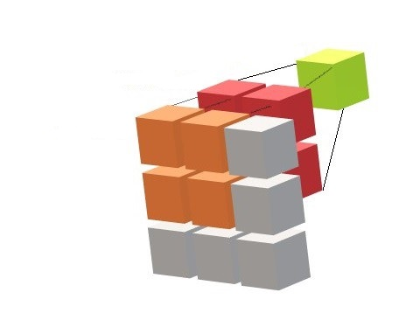
Introduction to Convolutional Neural Networks
Part-I
Notes:
1

Slide 2
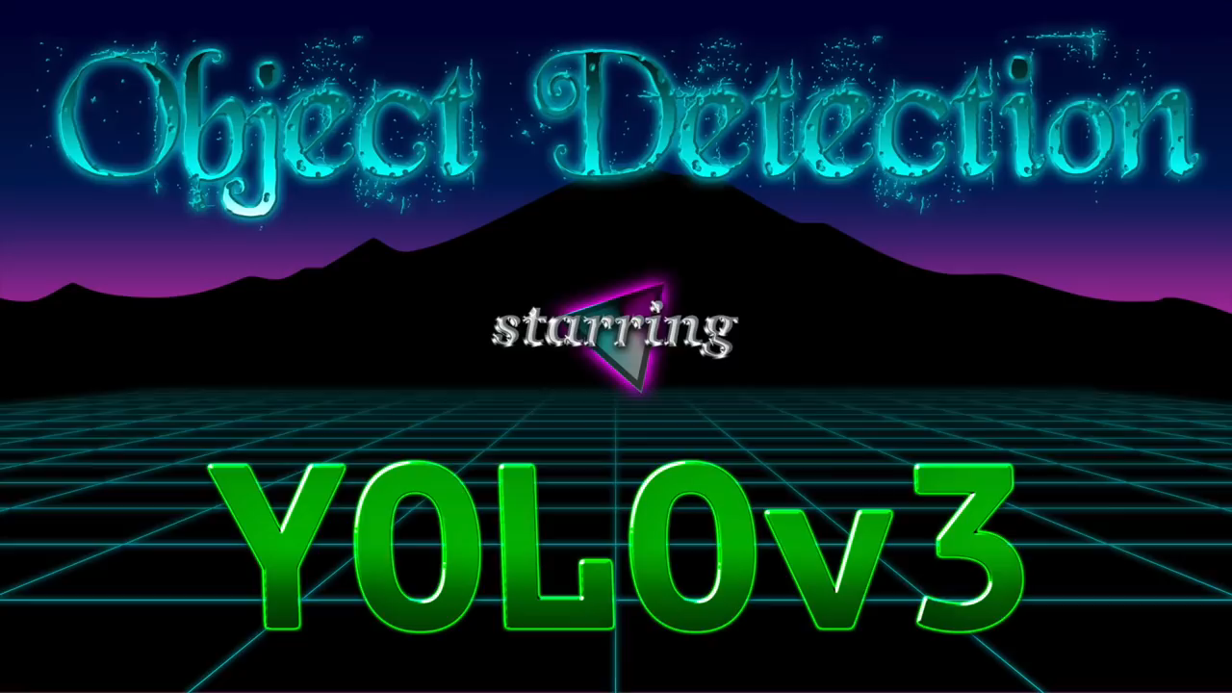
What a CNN can do?
Courtesy:
Joseph Redmon
Notes:
2

Slide 3

What a CNN can do?
Courtesy:
AlphaGo Movie
Notes:
3

Slide 4
CNN is only for Images?
Speech?
AlphaGo and Chess boards?
Videos?
Notes:
4

Slide 5

Convolutional Neural Networks
Notes:
5

